Slide 1
Intro to Node
and React
Front-End Web Development

Slide 2
node and npm
Intro to Node and React
Notes:
[X] MINUTES FOR THIS SECTION
SECTION NOTES
Bullet points on what the section includes, how it fits into the course.
Expressed goals for the section.

Slide 3
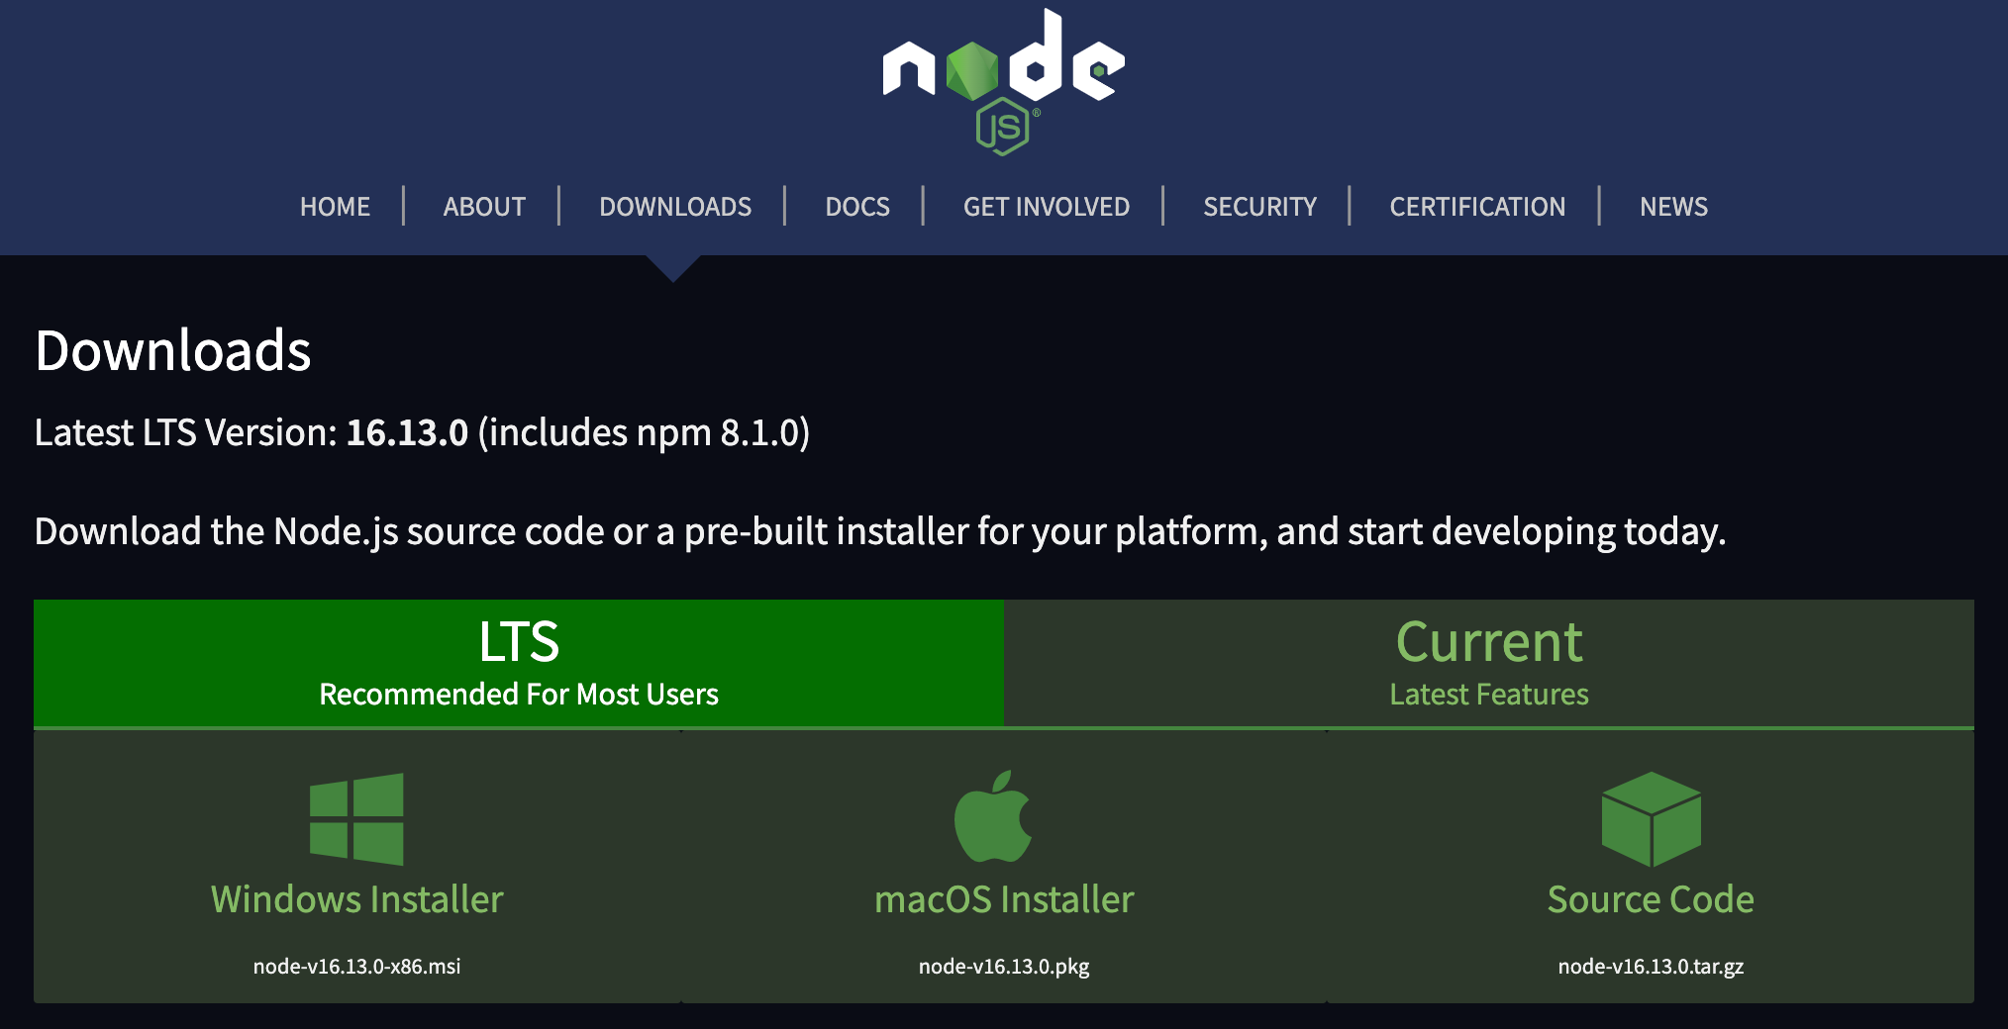
Node
Node.js® is a JavaScript runtime built on Chrome's V8 JavaScript engine.

Slide 4

NPM
npm is a package manager for the JavaScript programming language maintained by npm, Inc. npm is the default package manager for the JavaScript runtime environment Node.js. It consists of a command line client, also called npm, and an online database of public and paid-for private packages, called the npm registry.

Slide 5
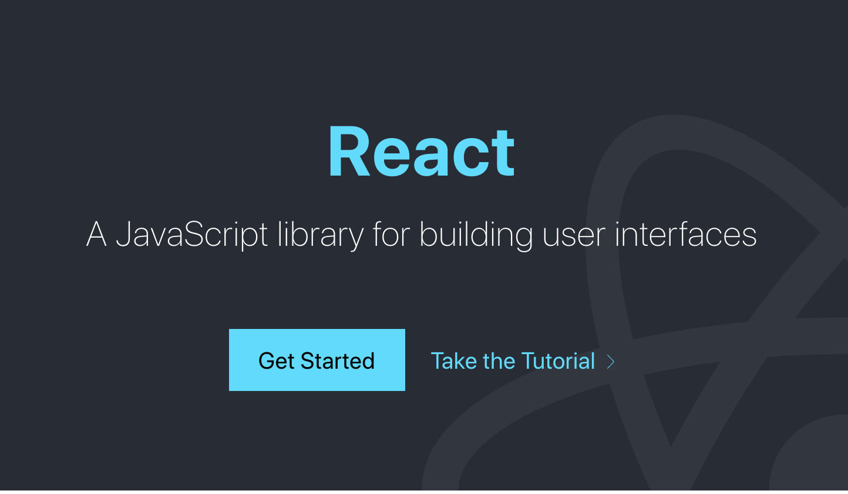
React
React is a free and open-source front-end JavaScript library for building user interfaces based on UI components. It is maintained by Meta and a community of individual developers and companies. React can be used as a base in the development of single-page or mobile applications.

Slide 6
Installing Node and npm - mac
Open your terminal. You can search for it using spotlight if you are unsure of how to find it.
$ brew update
$ brew install node
This might take a min to update your homebrew software. Be patient, don’t close the window.
This should only take a min.

Slide 7
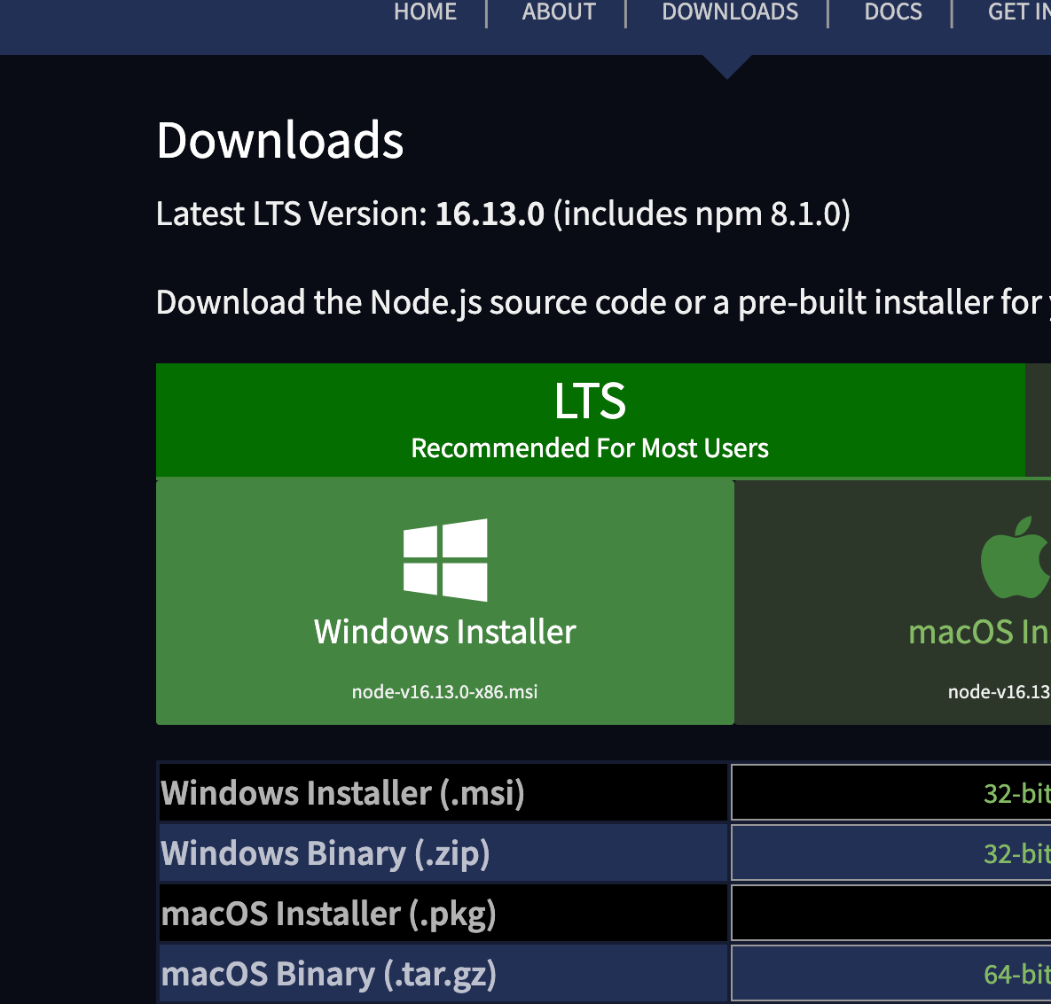
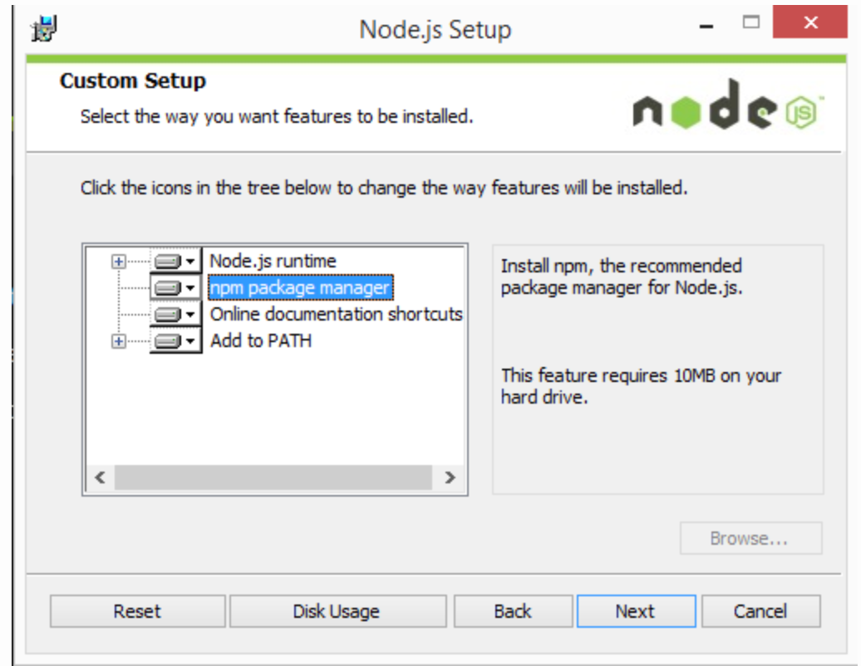
Installing Node and npm - windows
Download the windows installer from nodejs.org
Click “Next” several times to accept all default settings.

Slide 8
All together now
Mac - close and reopen your terminal window.
Windows - open cmd (search in start menu if you can’t find it)
$ node -v
$ npm -v
If the install was successful, this command will get you a node version printed to the console.
If the install was successful, this command will get you an npm version printed to the console.

Slide 9
Test Node
Create a new project folder on your desktop.
Create a new script.js file inside the project folder.
Add a console.log( “Testing node for the first time!” )
From your console window navigate into your project.
Run your js file with node:
$ node script.js

Slide 10
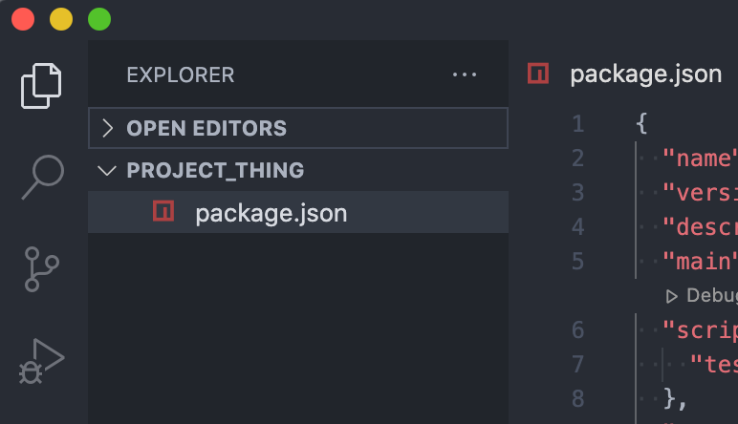
Test npm
From the console window, cd into your project folder
Type the command $ npm init this command will INITialize the node package manager and add a special file for tracking dependencies in your project folder.
Answer the prompts to create your first package.json file!

Slide 11
Demo: Add a package with npm
Let’s add a fun new package with npm:
url:
https://www.npmjs.com/package/colors

Slide 12
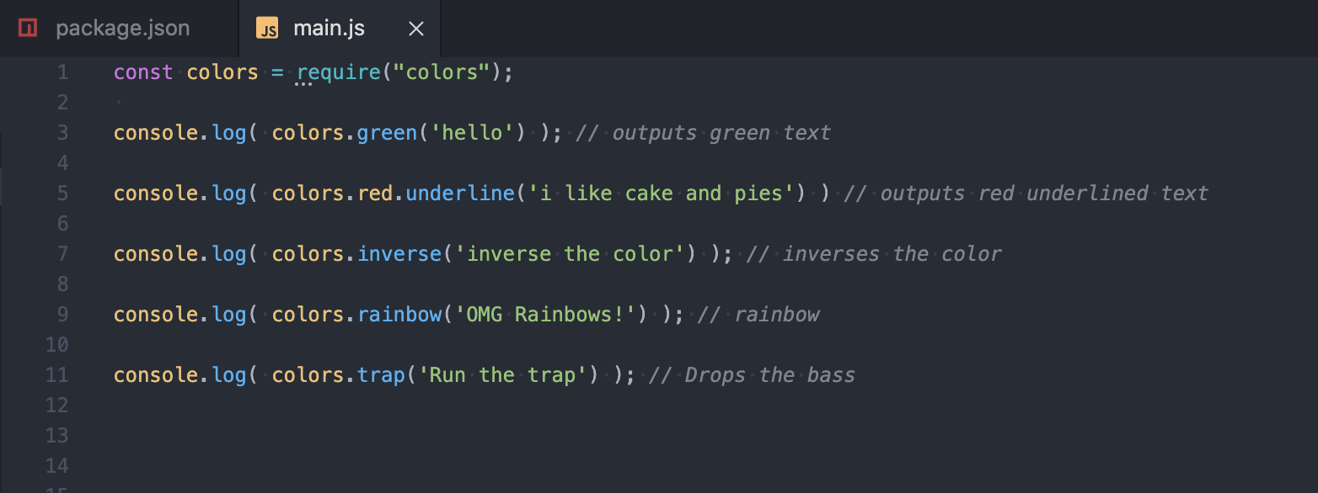
Demo Add a package
$ npm install -–save colors
Read the docs and take it for a spin!

Slide 13
node_modules
npm downloads all the code needed to make your fun new packages work and stores it all in a folder called node_modules.
As you can imagine, this file can get very large the more packages or dependencies your project uses.
Because they are so large, it is not best practice to commit them with git or push them to github. This can add thousands of files to your project and take forever to upload.
The solution: gitignore

Slide 14
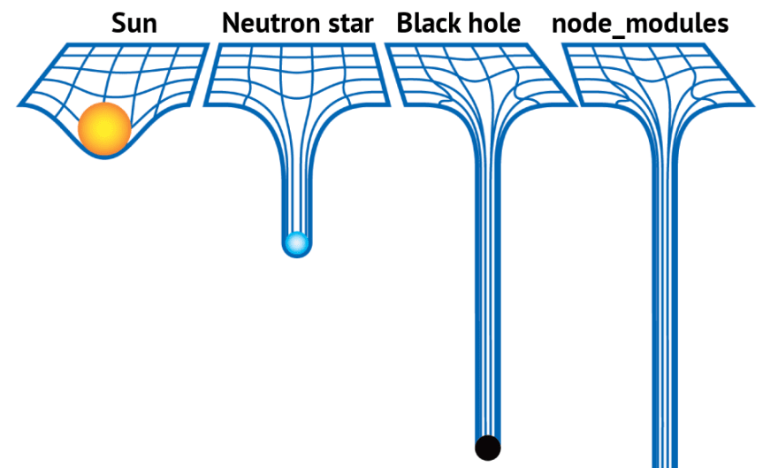

Slide 15
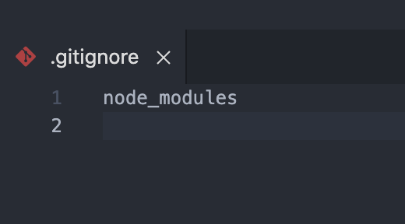
Gitignore
If you are using git to track changes in your project, you will need to create a file called a .gitignore.
As the name implies anything listed in the .gitignore is ignored when you commit your changes.
For this project all we need to list is the path to our node modules - they are in the same directory, so we just say “node_modules”
When creating a new project, always
do this step first so you don’t accidentally
make an initial commit with your
node modules.

Slide 16
Add a new package with npm
10 minutes
url:
https://www.npmjs.com/package/cow.io
Notes:
Purpose: One sentence about why this slide is included/how it gets us closer to our learning goals.
TALKING POINTS
This is a suggested talking point for instructors.
Bullets are better than paragraph-y scripts.
TEACHING TIPS
Have a suggestion for what an instructor should do while teaching to this slide? Put it here!
This is an optional section. Not all slides require facilitation tips.

Slide 17
React
Intro to Node and React
Notes:
[X] MINUTES FOR THIS SECTION
SECTION NOTES
Bullet points on what the section includes, how it fits into the course.
Expressed goals for the section.

Slide 18
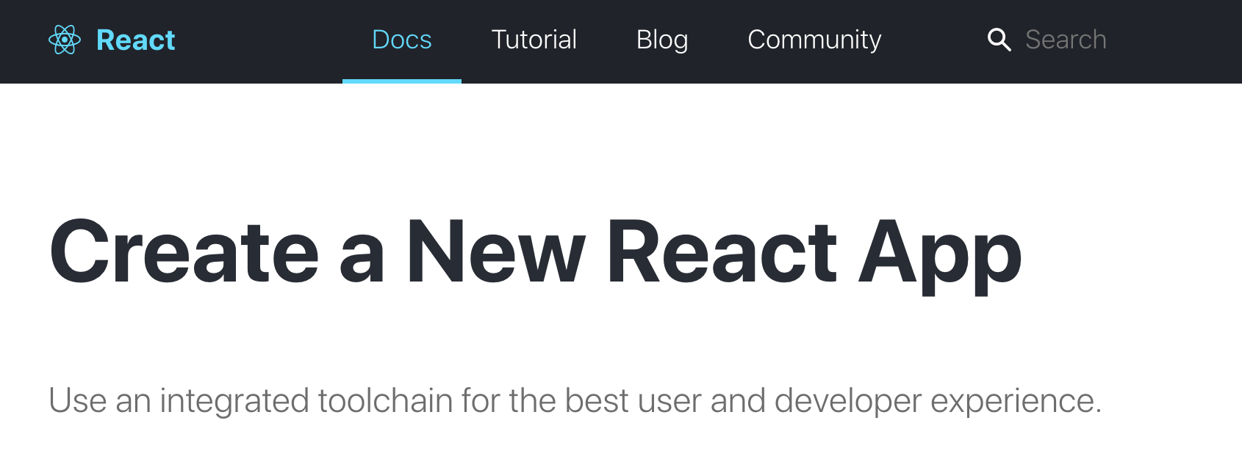

Slide 19
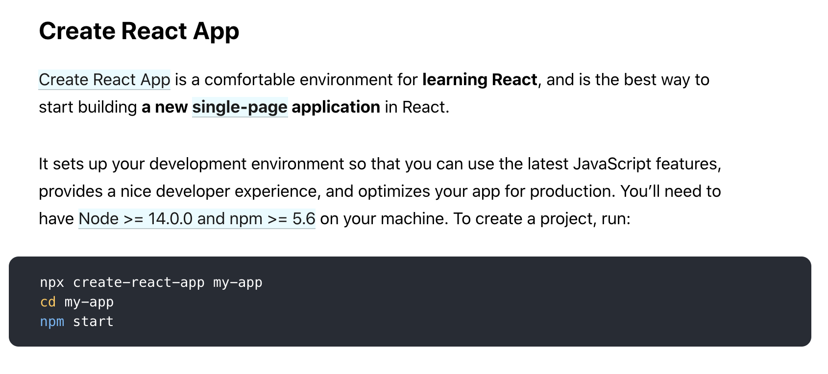

Slide 20
Build a Scoreboard App with multiple components
App
Scoreboard
Button

